Slide 1
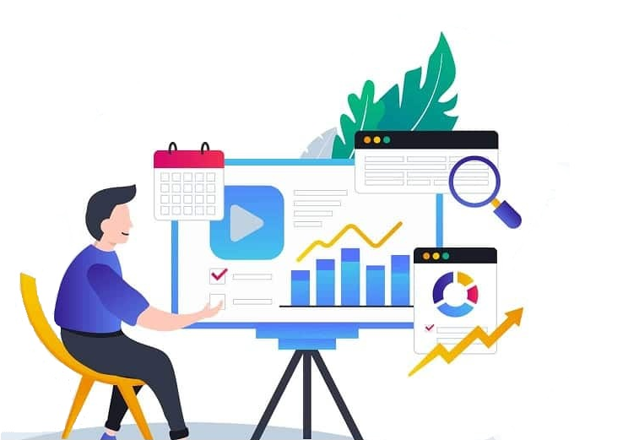
Big Data:
Transforming the Digital World

Slide 2
Abstract
Big data is a term for massive data sets having large, more varied and complex structure with the difficulties of storing, analyzing and visualizing for further processes or results. Big data analytics is the practice of analyzing vast amounts of data to uncover hidden patterns and concealed connections. Businesses or organizations can use these helpful details to obtain deeper and more profound insights and acquire a competitive edge. Because of this, large data implementations must be as carefully planned and carried out as feasible. An overview of big data's content, scope, samples, methodologies, benefits, and obstacles is given in this study, along with a discussion of privacy concerns.

Slide 3
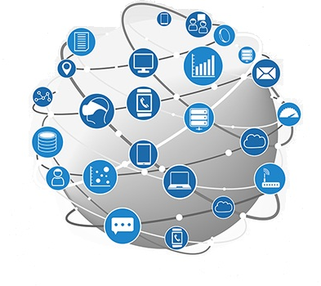
Introduction of BIG DATA
Big Data is a collection of data that is huge in volume, yet growing exponentially with time. It is a data with a large size and complexity that none of traditional data management tools an can store it or process it efficiently. Approximately 1000+terabytes of data get ingested into the databases of social media site like Instagram, Facebook, and everyday. This data is mainly generated in terms of photo and video uploads, message, putting comments etc.

Slide 4
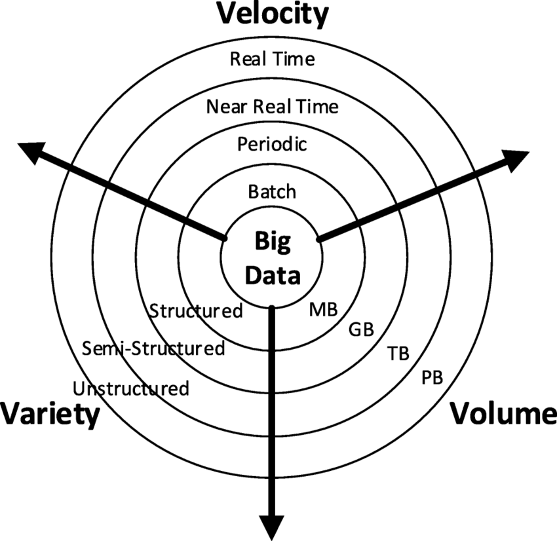
Characteristics
BIG DATA is characterized by the 3 Vs: Volume, Velocity, and Variety. This presents significant challenges for traditional data processing and analysis techniques face many difficulties as a result, requiring creative solutions to handle and gain useful information from this massive amount of data.
Volume
.
It refers to the sheer amount of data generated and stored by organizations. Data volume has grown to terabytes and petabytes in recent years.
2. Velocity
Velocity refers to the speed at which data is generated, transmitted, and processed, often in real time or near real time.
3. Variety
Variety in big data refers to the diversity of data types and formats ranging from structured data in databases to unstructured data such as text, images, videos, and sensor readings all coming from multiple sources

Slide 5
Problem Statement
Explosion of Data
It is challenging to effectively manage, store, and interpret the abundance of information that has resulted from the quick expansion of data generation across businesses. Because of this, handling these enormous datasets requires new technologies and approaches, which present serious hurdles for both enterprises and data scientists.
2. Data Complexity
BIG DATA often encompasses diverse data types, including structured and unstructured data, making it difficult to integrate, analyze, and extract meaningful insights. To handle and evaluate this complicated data efficiently, specific tools and methods are needed.
3. Real-Time Insights
One of the biggest challenges is the requirement for real-time insights and BIG DATA decision-making. New strategies are required to enable quick analysis and action because traditional data processing techniques frequently can't keep up with the amount and pace of data generation.

Slide 6
Research and Findings
Advanced Information Analysis: Businesses may make better judgments by using methods like statistical analysis, machine learning, and deep learning to derive valuable insights and predictions from large datasets.
Data Visualization: Stakeholders can better understand the data and more easily grasp complicated insights when patterns and trends are visualized via interactive dashboards and visualizations.
Data Governance and Management: Building strong data governance frameworks and data management procedures is essential to guaranteeing data security, quality, and regulatory compliance, as well as to promote trust and responsible data use.
Cloud Computing: Businesses may take use of the potential of these technologies without having to make large upfront investments thanks to cloud-based platforms, which offer scalable and affordable solutions for storing, processing, and analyzing BIG DATA.

Slide 7
Opportunities
Business Intelligence: Big Data gives companies important insights into market trends, customer behavior, and operational effectiveness, which improves decision-making and gives them a competitive edge.
Scientific Discovery: Big Data is used by researchers in many disciplines to examine enormous datasets, leading to ground-breaking findings in astronomy, medicine, climate science, and other subjects.
Personalized Experiences: Big Data makes it possible for consumers in a variety of industries to have individualized experiences, from tailored product recommendations to targeted advertising, which increases customer satisfaction and engagement.

Slide 8
Challenges
Data Security Strong security measures and data encryption techniques are necessary to protect sensitive data from breaches and unauthorized access, particularly as BIG DATA grows in volume and complexity.
Data Privacy Following data privacy laws and ethical standards is essential to ensuring appropriate data gathering and use to safeguard individual privacy.
Data Quality Reliable insights can only be obtained from BIG DATA by maintaining data quality, correctness, and consistency, which calls for extensive data cleansing and validation procedures.
Skill Gap Education and training programs are necessary to close the skills gap in the fast changing field of BIG DATA, which requires a workforce with knowledge of data analysis, machine learning, and related technologies.

Slide 9
Conclusion
Across all industries, Big Data offers countless chances for innovation and advancement, allowing companies to improve efficiency, gain insightful knowledge, and customize experiences. Addressing ethical issues pertaining to prejudice, data security, and privacy is essential to guaranteeing responsible data use for the good of society. The future of numerous sectors will be shaped by the ongoing research and development in data analytics, machine learning, and associated technologies, which will further unlock the potential of Big Data.

Slide 10
Thank You!

